Slide 1
Earth electrode resistance
PowerPoint presentation
Unit 304: Electrical Installations: inspection, testing and commissioning

Slide 2
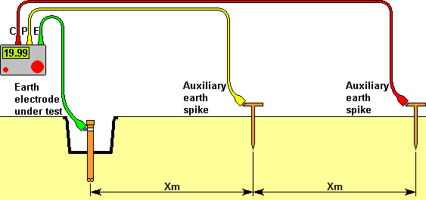
Earth electrode resistance
Initial test

Slide 3
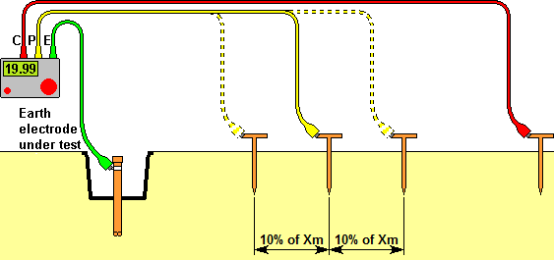
Earth electrode resistance
Check for overlapping resistance areas

Slide 4
Earth electrode resistance
NB: Where a measurement of R_{A} is not practicable the measured value of external earth fault loop impedance may be used.

Slide 5
Any questions?

